Slide 1

Data Science
Final project

Slide 2
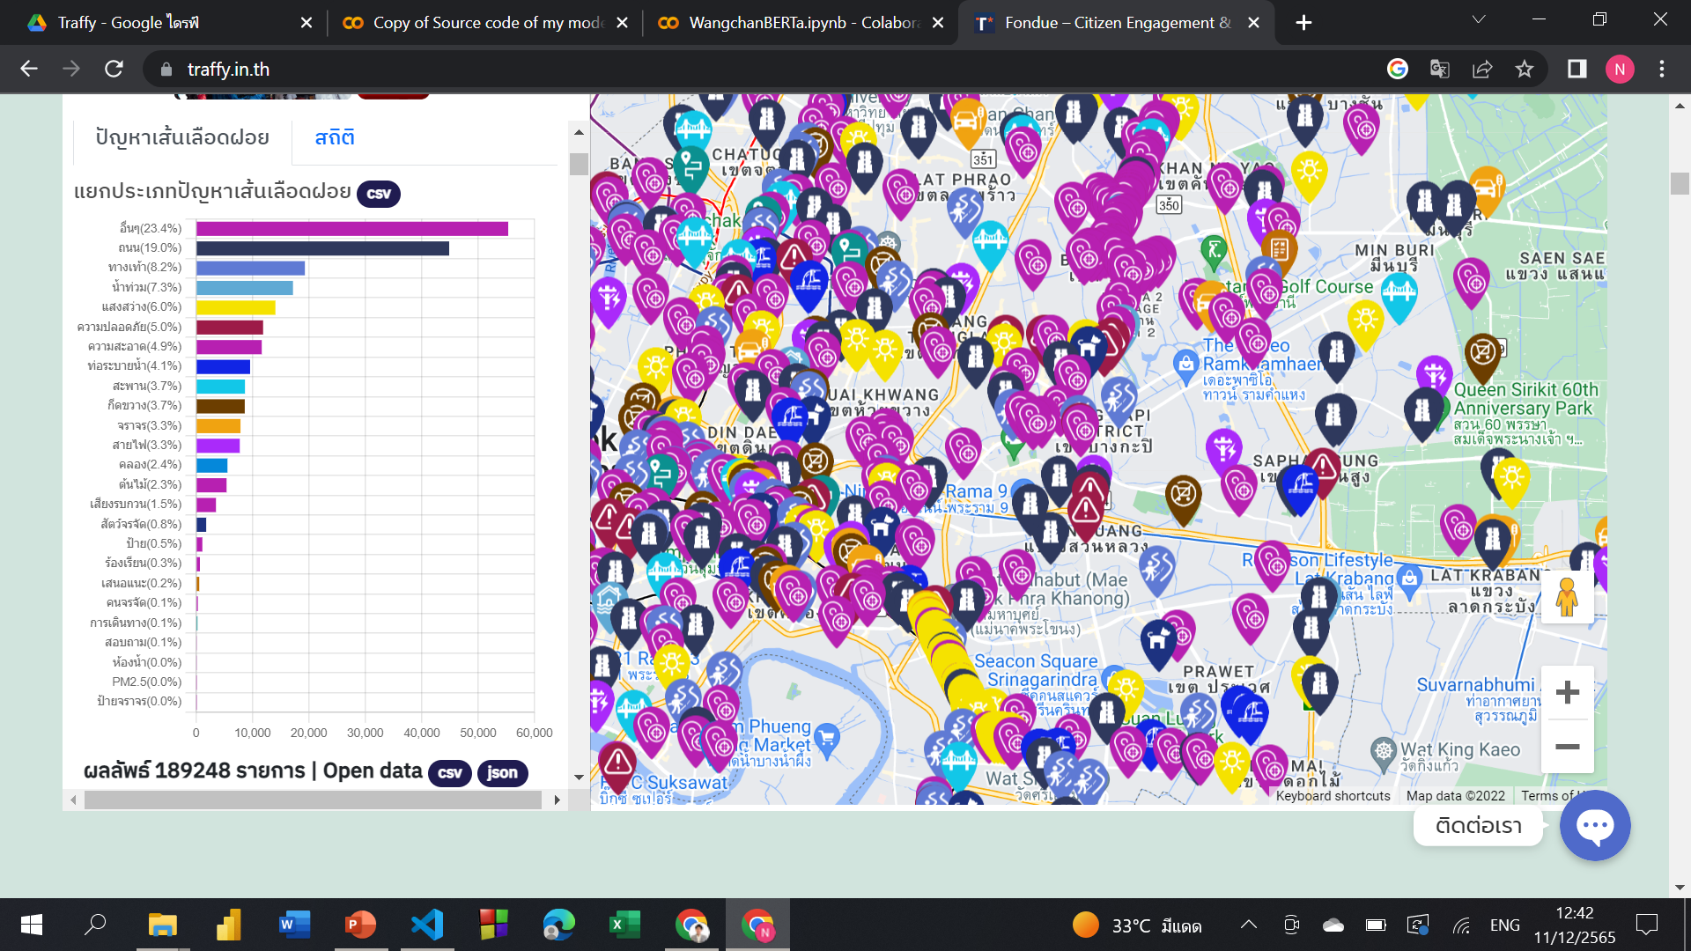
Purpose
No category
Get ignored
X
Labeling by staffs
Take action
Labeling by Deep learning model

Slide 3
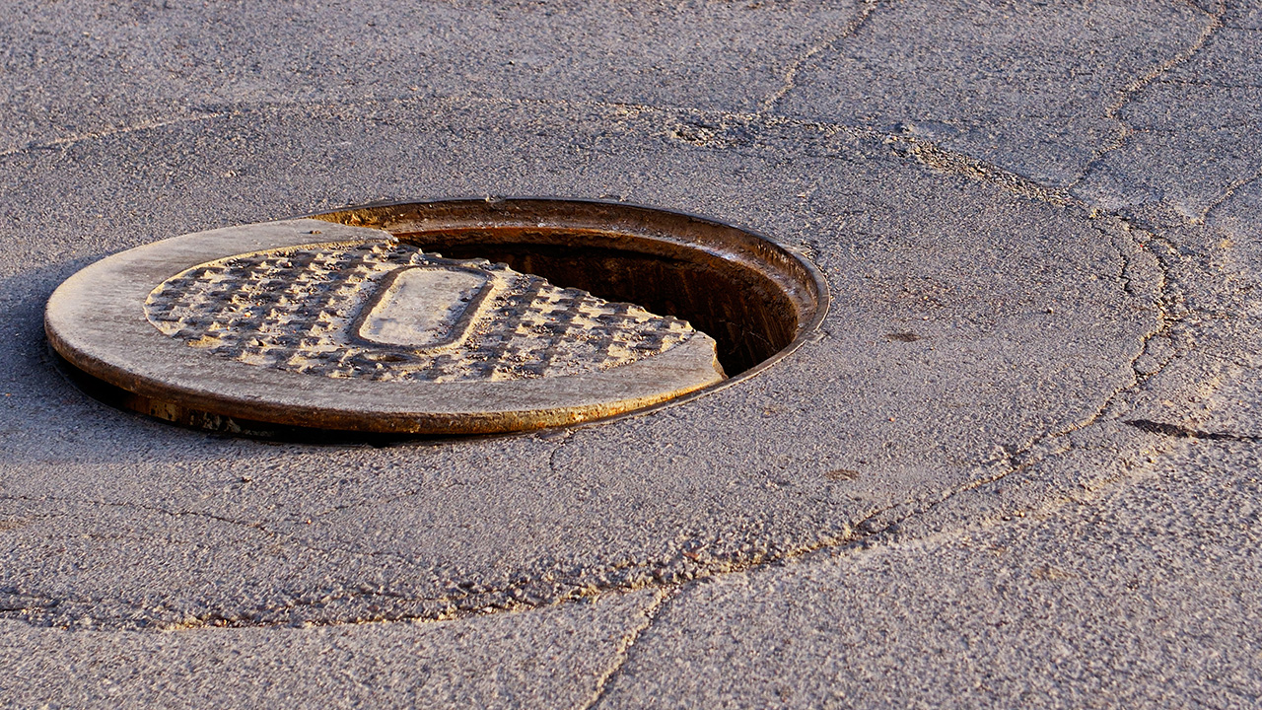
Label prediction
No category
“ฝาท่อพังช่วยซ่อมด้วย”
Language model
Label_1
If Label_1 = Label_2 then add data to that category.
Image model
Label_2

Slide 4
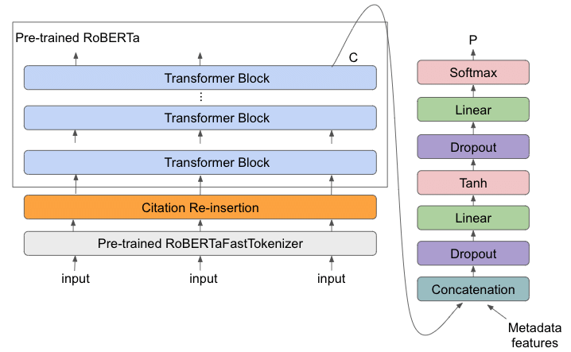
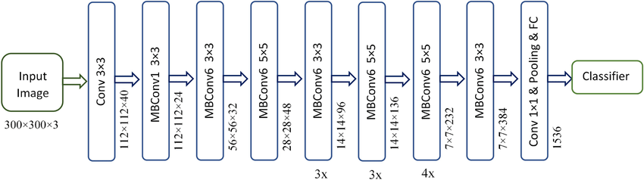
Deep Learning model
Text classification model
Image classification model
RoBERTa-based transformer model (Pre-trained weight with WangchanBERTa)
EfficientNetV2-B3-based model (Pre-trained weight with ImageNet)
Image from: https://www.researchgate.net/figure/The-RoBERTa-model-architecture_fig2_352642553 and https://www.researchgate.net/figure/Schematic-representation-of-EfficientNet-B3_fig2_359449935

Slide 5
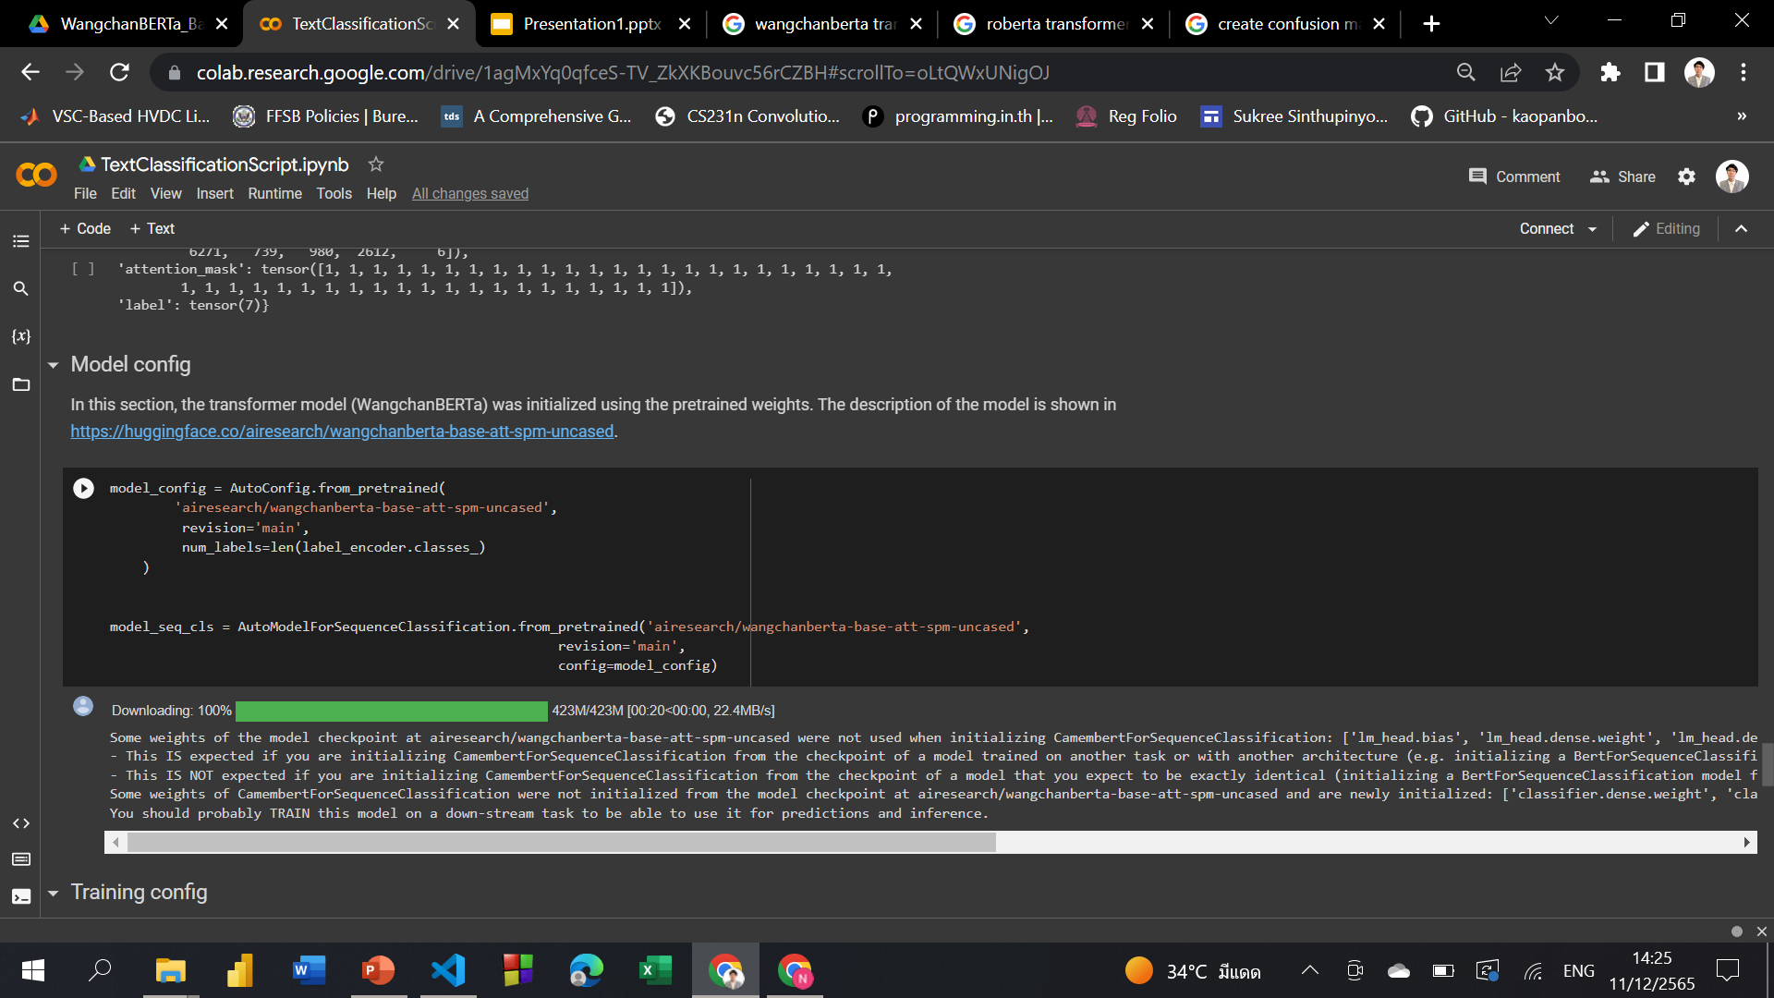
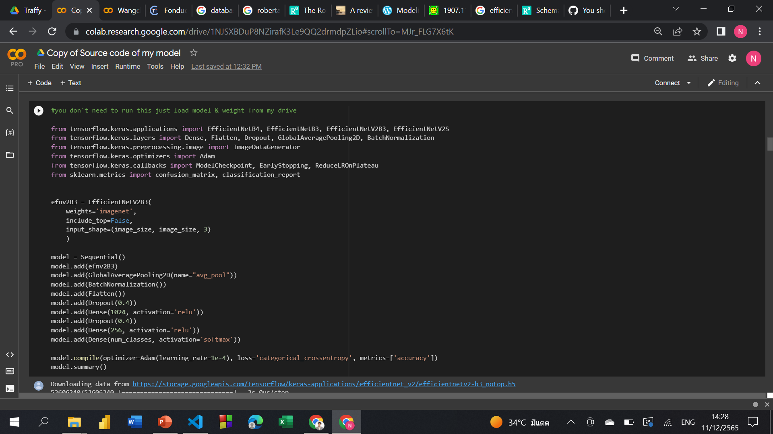
Model config
Text model
Image model

Slide 6

Process overview
'LABEL_0': 'กีดขวาง’,
'LABEL_1': 'คลอง’,
'LABEL_2': 'ความปลอดภัย', 'LABEL_3': 'ความสะอาด', 'LABEL_4': 'จราจร’,
'LABEL_5': 'ต้นไม้’,
'LABEL_6': 'ถนน’,
'LABEL_7': 'ทางเท้า’,
'LABEL_8': 'ท่อระบายน้ำ', 'LABEL_9': 'น้ำท่วม’,
'LABEL_10': 'สะพาน', 'LABEL_11': 'สัตว์จรจัด', 'LABEL_12': 'สายไฟ'
Language model:
RoBERTa Transformer
# = 32549
Training set
# = 6973
comment
Image
Validation set
Data
Image model: EfficientNetV2-B3
# = 6973
Test set

Slide 7
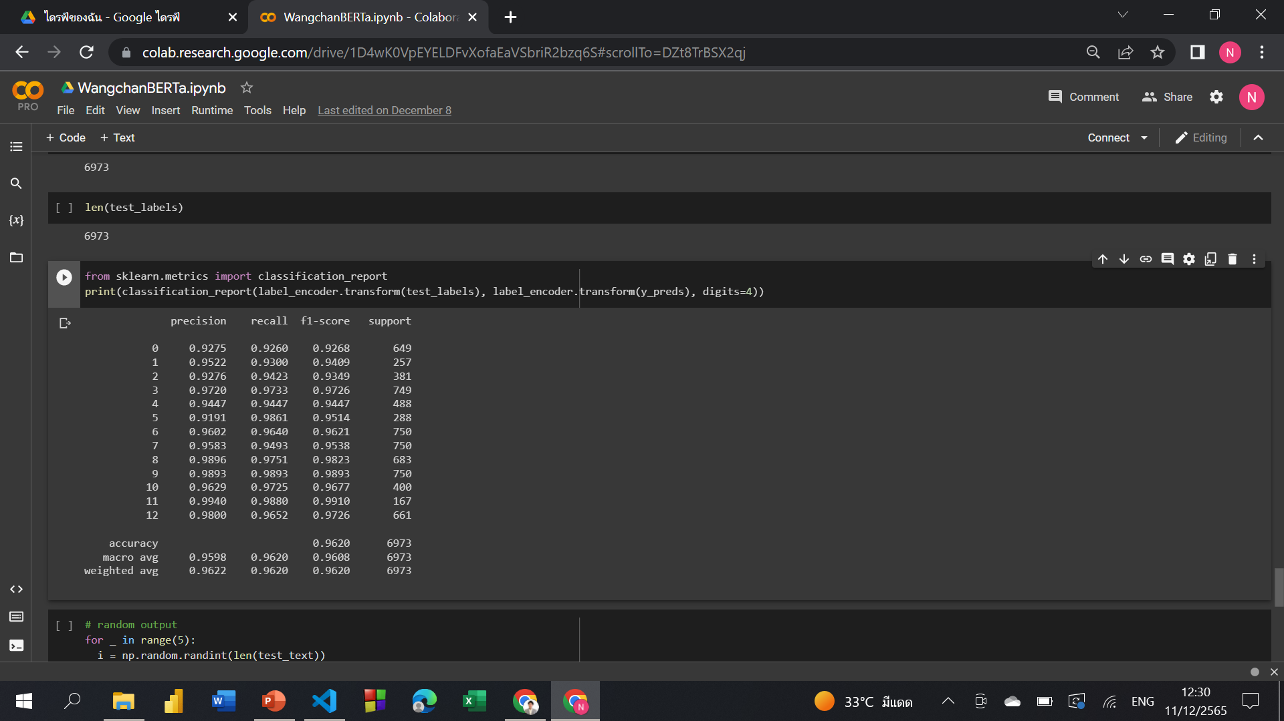
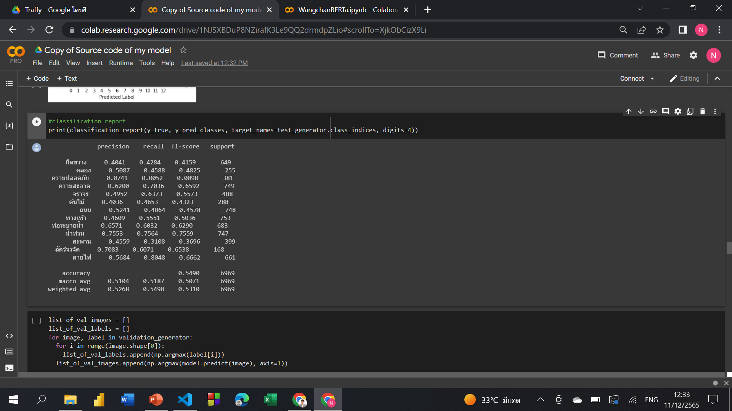
Classification report on test set
Text classification report
Image classification report

Slide 8
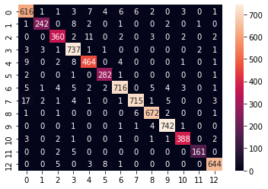
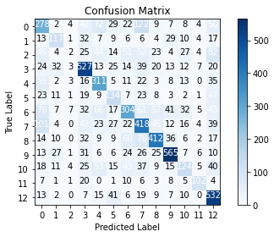
Confusion matrix on test set
Text classification
Image classification

Slide 9


